Slide 1
PHYS60022 Data Science and Machine Learning for Physics
Week 4: Parameter Estimation
Spring 2025

Slide 2
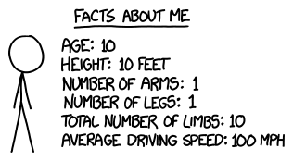
Introduction to Estimation
In one sense, all of machine learning including AI (whatever that difference is) is really about applying some function to your data and finding the "best" values for the parameters in your functions.
This could be the weights in the links in the neural network (the function here is not in a standard form we know) or, as you have done before in labs, it could be fitting a curve to data
xkcd.com

Slide 3

Introduction to Estimation
In one sense, all of machine learning including AI (whatever that difference is) is really about applying some function to your data and finding the "best" values for the parameters in your functions.
This could be the weights in the links in the neural network (the function here is not in a standard form we know) or, as you have done before in labs, it could be fitting a curve to data
xkcd.com
This week, we will be looking at methods for estimating parameters and in particular using the Python package iminuit

Slide 4
Introduction to Estimation
In physics, it is common that we have a theory for a process which contains some parameters whose values are not known.
For example Newton's law of gravity has one unknown constant G while the standard model of particle physics has over twenty.

Slide 5
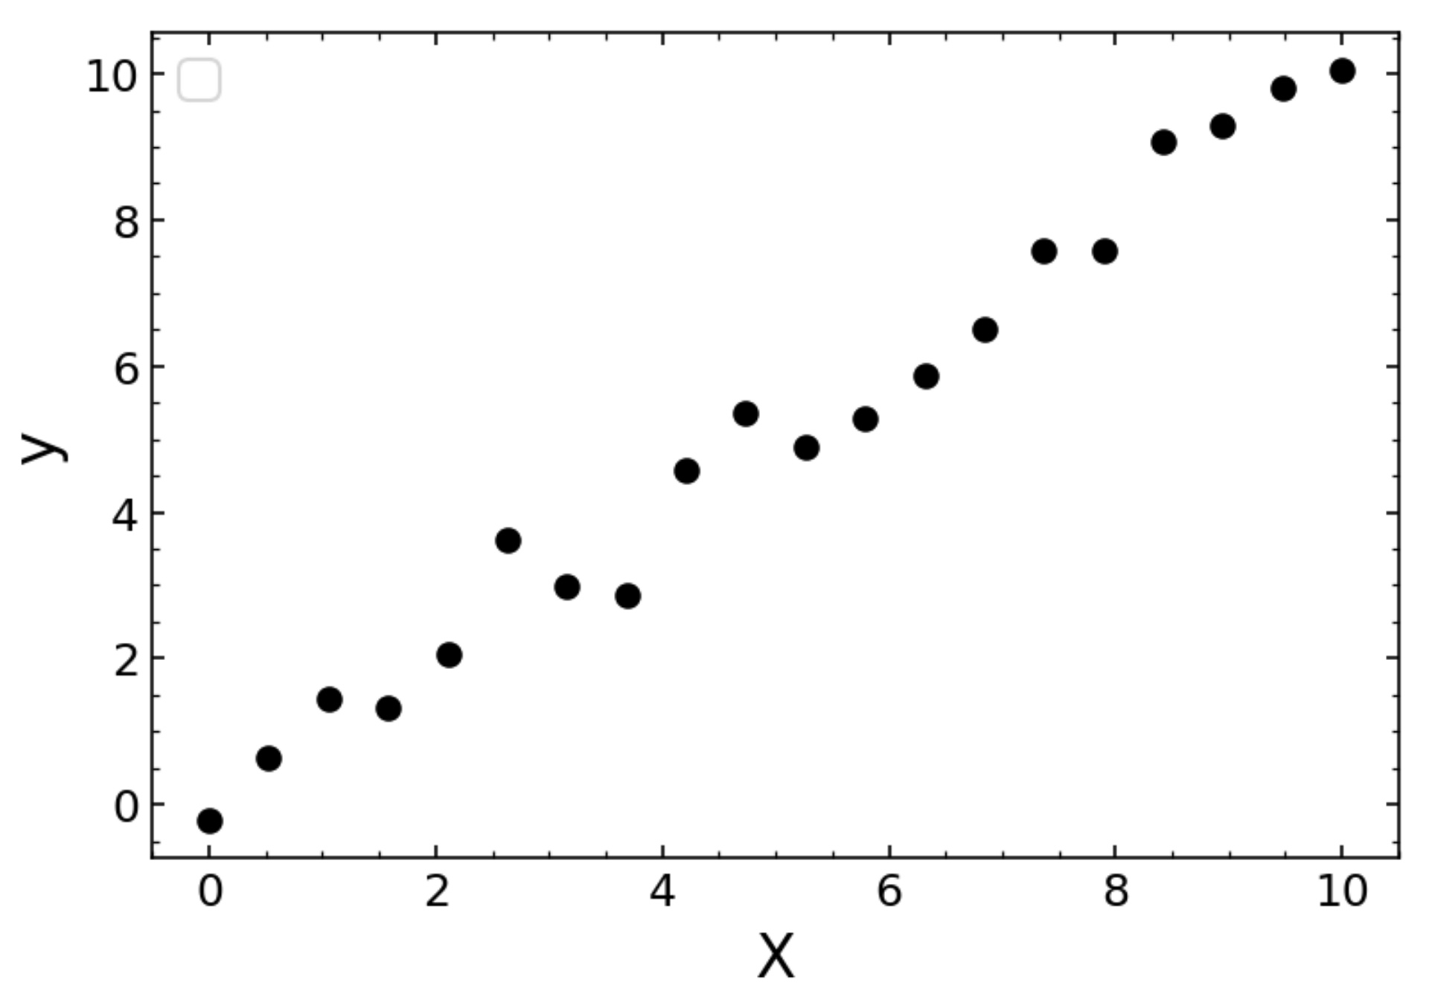
Introduction to Estimation
In physics, it is common that we have a theory for a process which contains some parameters whose values are not known.
For example Newton's law of gravity has one unknown constant G while the standard model of particle physics has over twenty.
The data taken in experiments is used to both test if a given theory is compatible with nature, and to make estimates of the parameters of that theory.

Slide 6
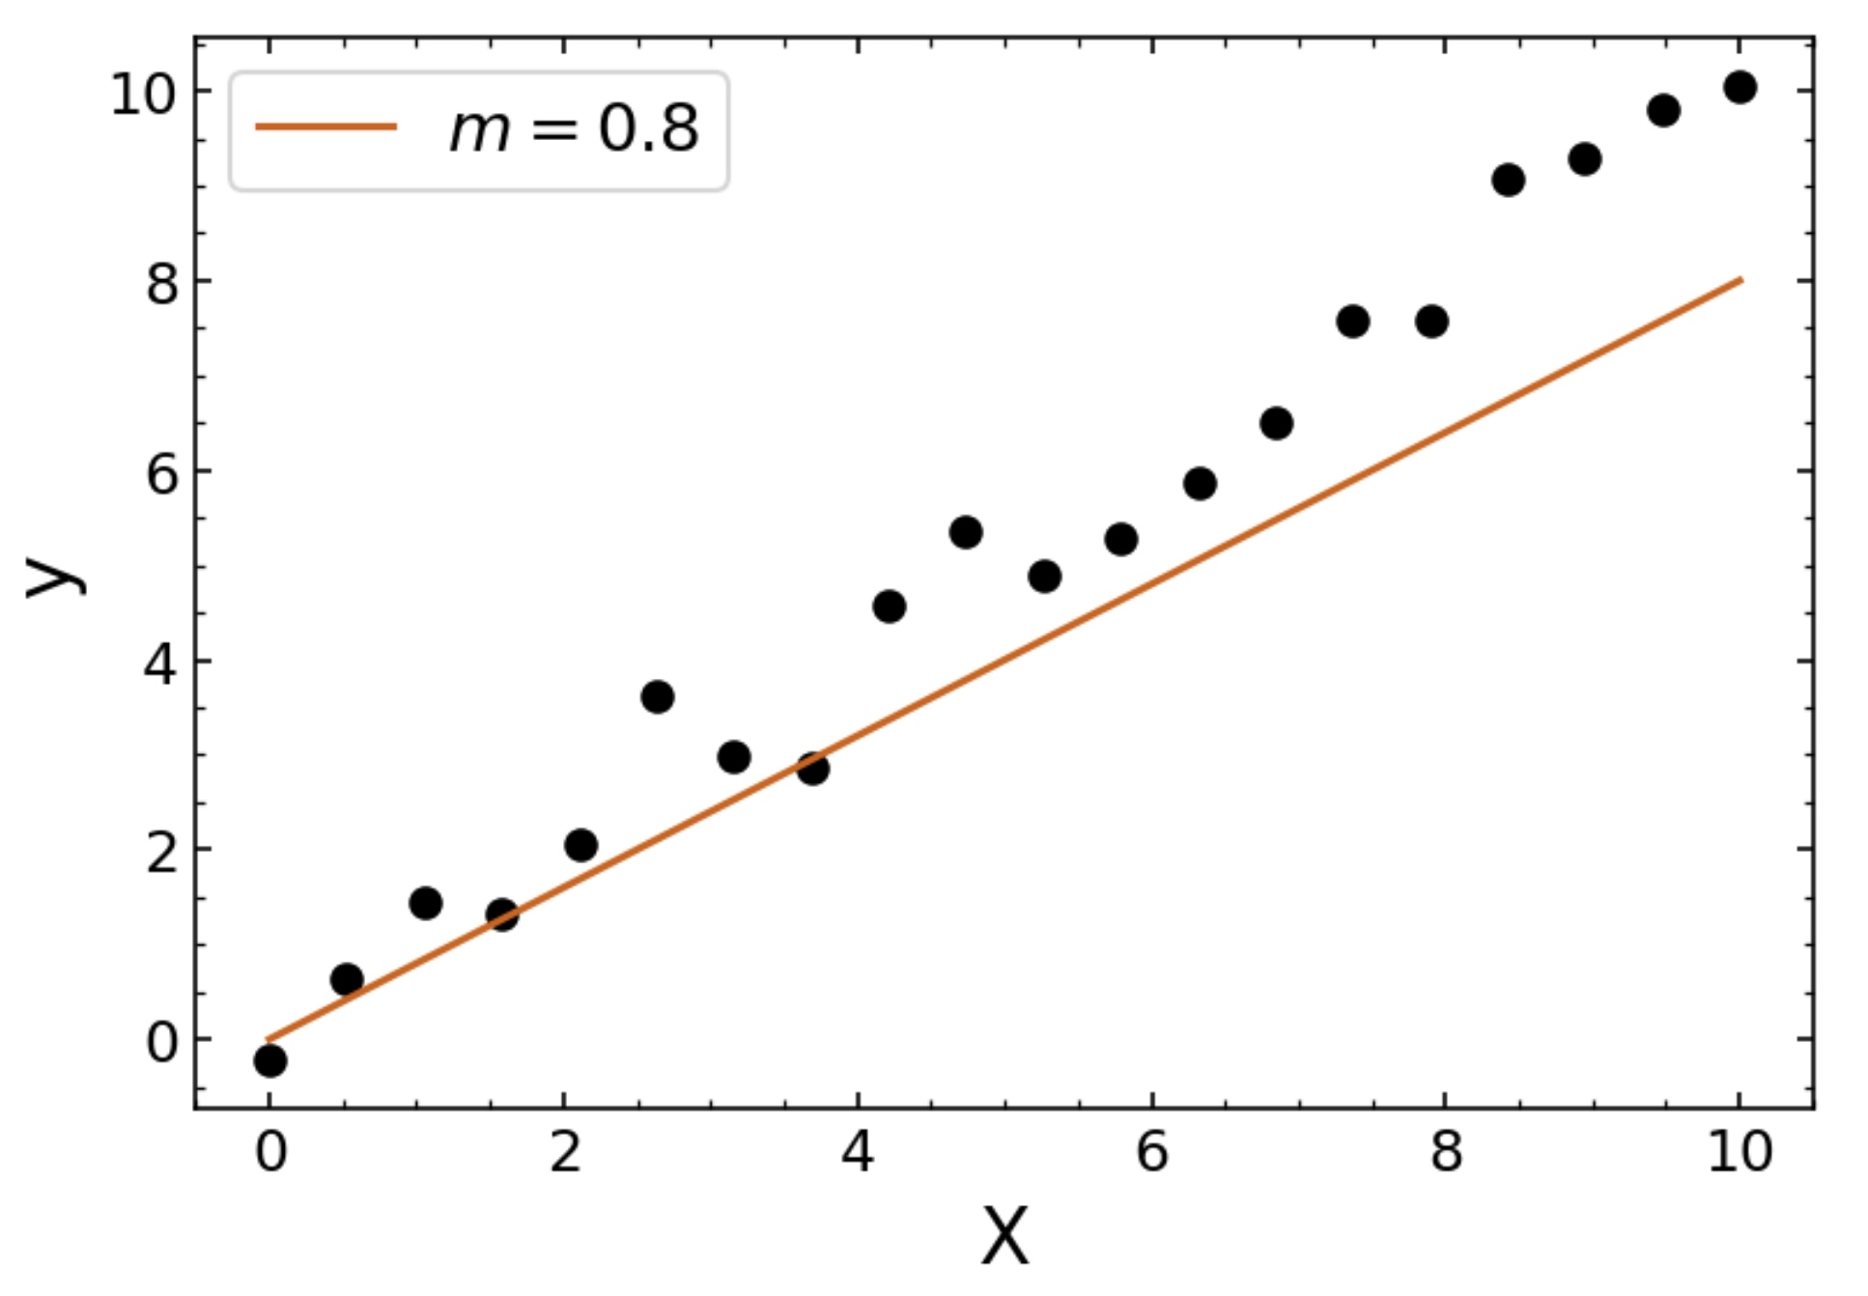
Introduction to Estimation
In physics, it is common that we have a theory for a process which contains some parameters whose values are not known.
For example Newton's law of gravity has one unknown constant G while the standard model of particle physics has over twenty.
The data taken in experiments is used to both test if a given theory is compatible with nature, and to make estimates of the parameters of that theory.
For example, we may want to check if the equation
y = mX is a good description of our data

Slide 7
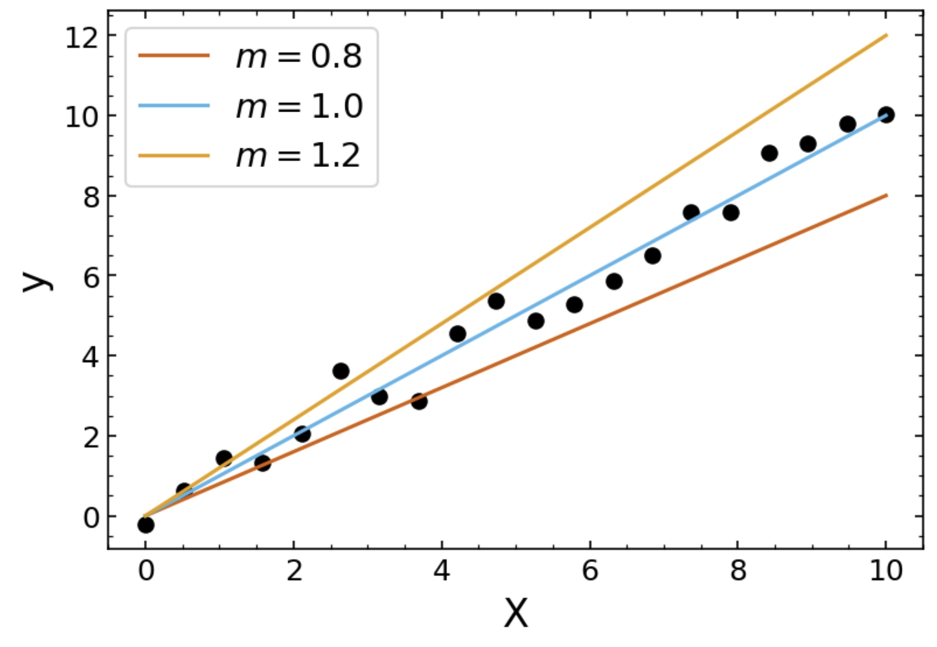
Introduction to Estimation
In physics, it is common that we have a theory for a process which contains some parameters whose values are not known.
For example Newton's law of gravity has one unknown constant G while the standard model of particle physics has over twenty.
The data taken in experiments is used to both test if a given theory is compatible with nature, and to make estimates of the parameters of that theory.
For example, we may want to check if the equation
y = mX is a good description of our data
And we may want to find the value of m that best describes that data

Slide 8
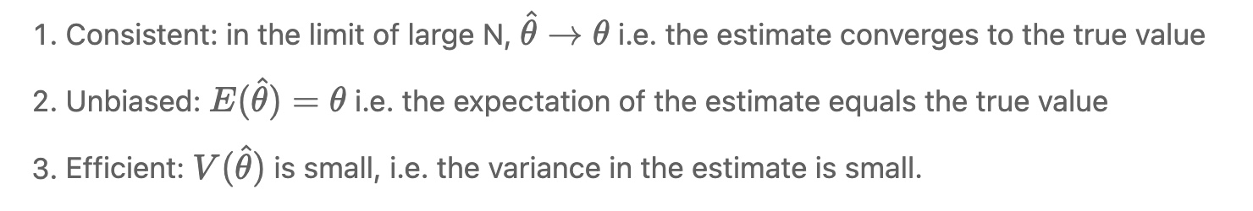
Good Estimates
We use the notation to represent the estimator of the parameter . The estimator is derived from data and so it is a random value
Many methods of estimation exist, where some are better than others. Good estimates are:

Slide 9
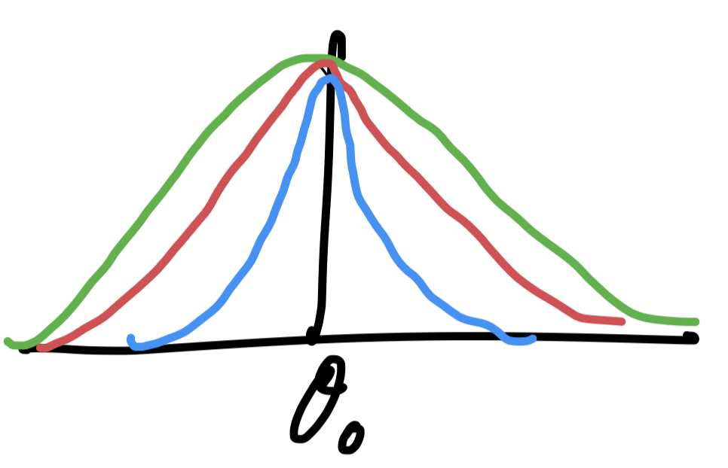
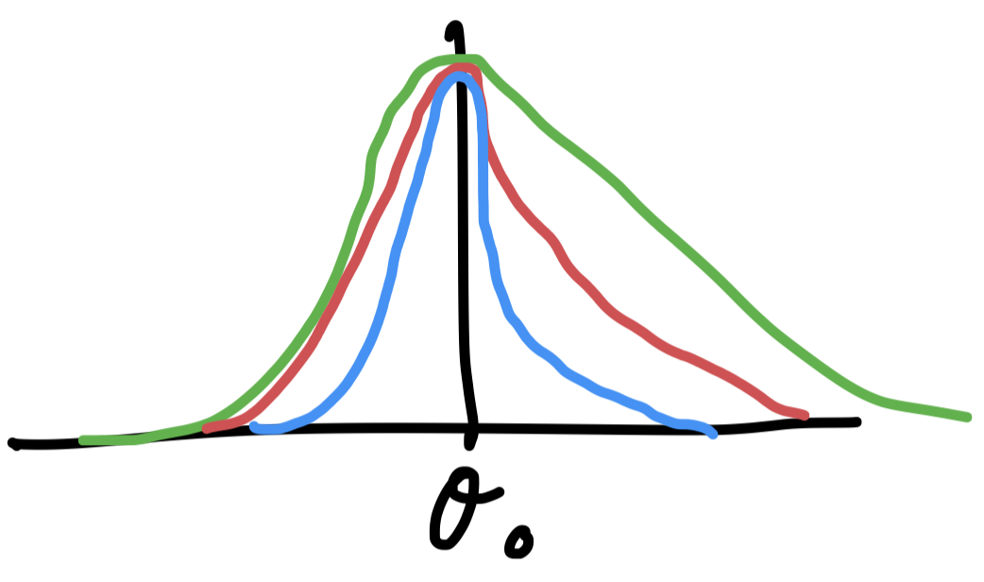
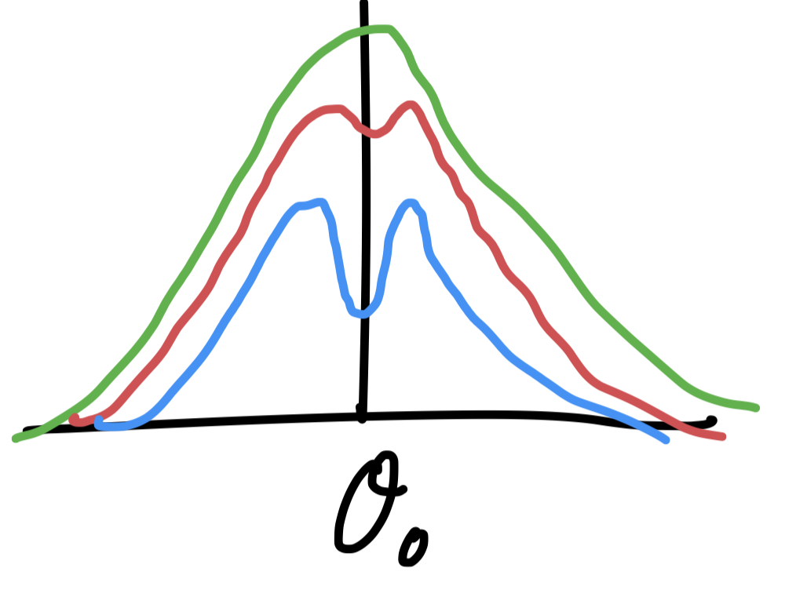
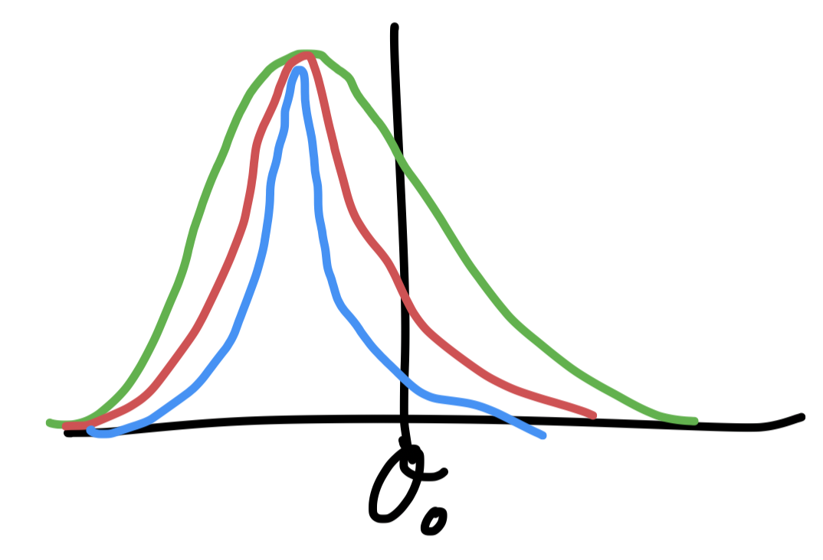
Good Estimates
We use the notation to represent the estimator of the parameter . The estimator is derived from data and so it is a random value
Many methods of estimation exist, where some are better than others. Good estimates are:
Consistent
Not-Consistent
Unbiased
Biased

Slide 10
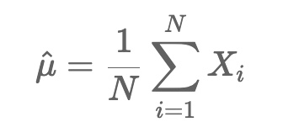
Example: Mean estimator
One of the most common methods of estimation that you may not have realised is formally an estimate: finding the mean of a set of measurements.
Given a set of data X_{i} , we find an estimate of the mean of the distribution using the sample mean

Slide 11
Example: Mean estimator
One of the most common methods of estimation that you may not have realised is formally an estimate: finding the mean of a set of measurements.
Given a set of data X_{i} , we find an estimate of the mean of the distribution using the sample mean
E.G If we wanted to find the mean of the Gaussian (μ) distribution that best described the data, we could use this estimate.
Remember μ is a constant but μ isn’t!
This particular estimator is consistent, unbiased and efficient
→ It is a good estimator
The process of finding the value of the estimator is sometimes
Referred to as “fitting”. In ML, it is called “regression”
^
model
observations

Slide 12
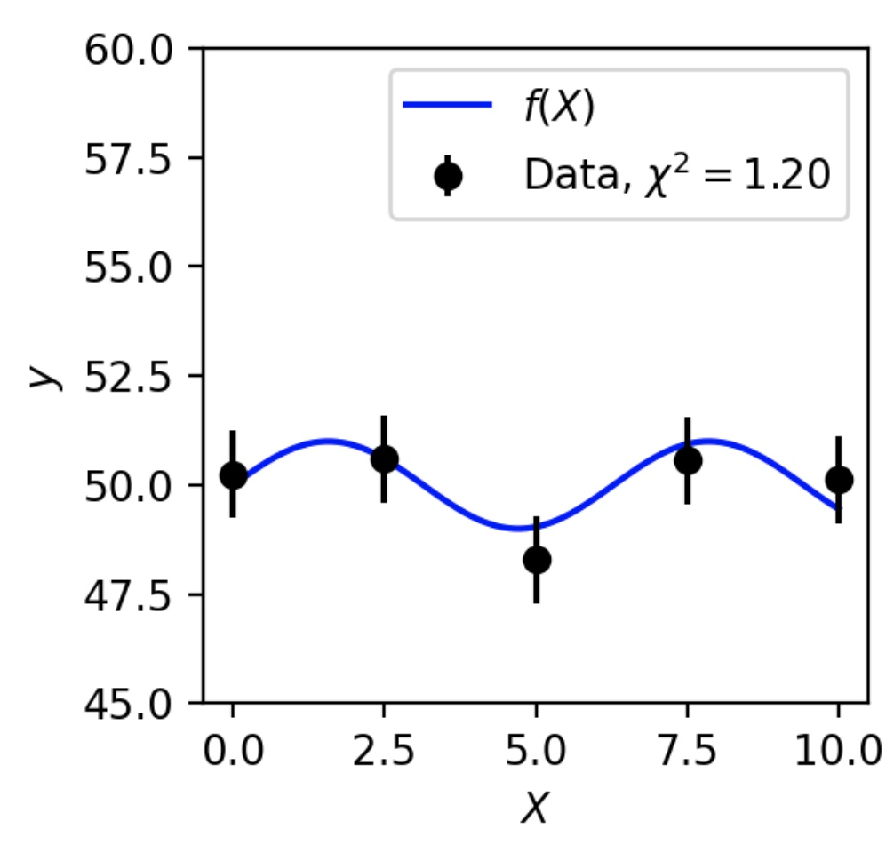
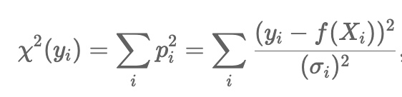
The χ² estimation method
Fitting typically works by defining some cost function (often called a loss function in machine learning) of our data and our proposed model (and associated parameters)
The aim is to maximise or minimise this function
In Week 2, we discussed the χ² value as a method for determining the compatibility of a given model to some experimental data.
We hypothesise the data is distributed with some Gaussian noise about the model prediction and test whether the measurements are consistent with that hypothesis.

Slide 13
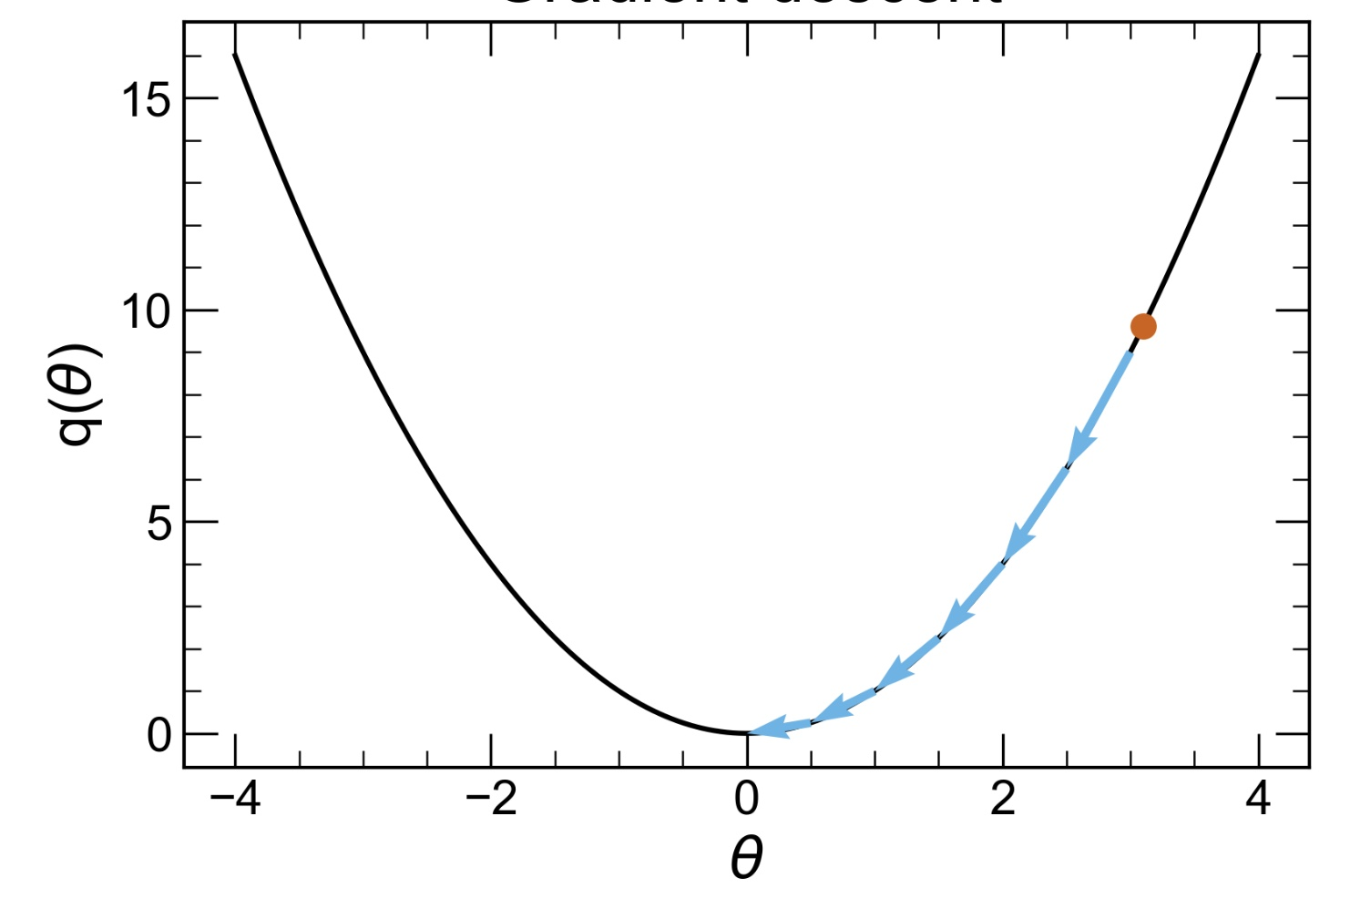
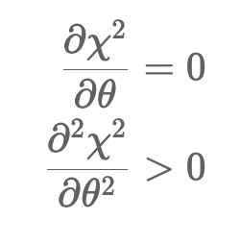
The χ² estimation method
We can take this concept further, and instead try to optimise the value of χ² by choosing different parameter values θ
We want to minimise χ² (θ)
In some cases, we can do this minimisation analytically, however for most real applications, we will end up using some algorithm – eg gradient descent

Slide 14
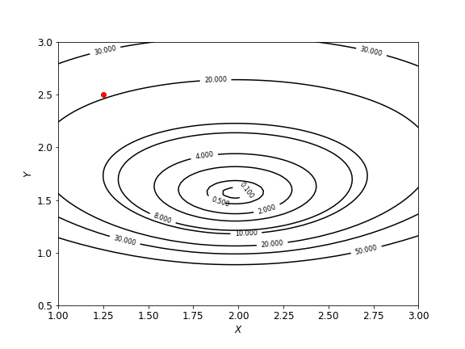
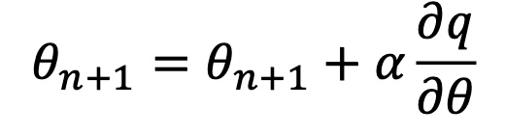
Gradient descent
Gradient descent works by walking along the direction of steepest descent
Define an initial parameter set guess θ_{init}
2. Calculate the gradient dq/dθ of the cost function q(θ)
3. Iterate
α is the LEARNING RATE
For this course, you won’t need to code these algorithms, instead we can use packages like iminuit, tensorflow etc
Contours in q

Slide 15
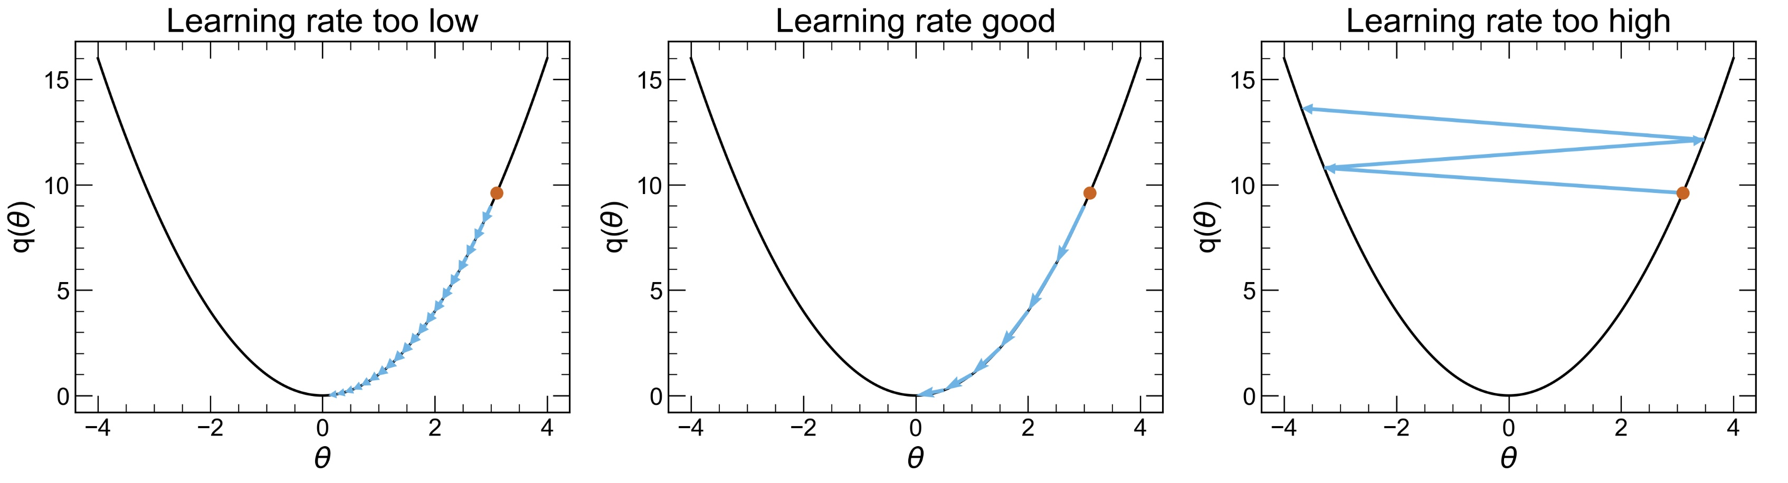

Gradient descent
Bear in mind that these algorithms come with their own (hyper)-parameters that you need to tune. For gradient descent, the learning rate (or step size) tells the algorithm how fast to walk along the gradient
We will see much more of this when training machine-learning models

Slide 16
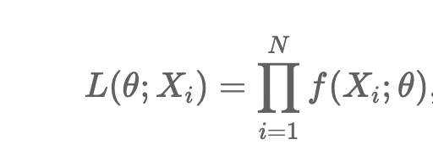
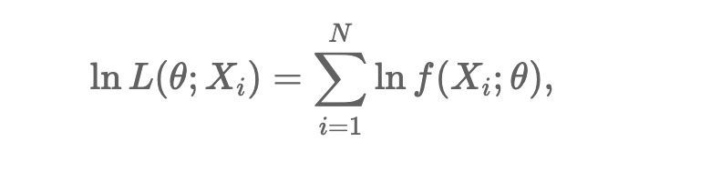
The negative log-likelihood
Another very popular loss function is the negative log-likelihood function
As with likelihood ratios, it is often more convenient to use the log-likelihood function to avoid dealing with very small numbers in products
Similar to what we saw last week, if we write the log-likelihood function for a set of Gaussian distributed measurements, we recover the χ² loss function
Estimates that come from maximising the likelihood function are known as maximum likelihood estimates

Slide 17
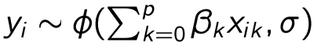
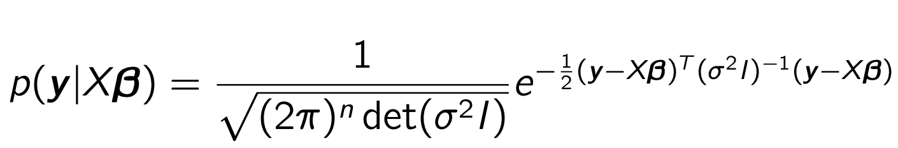
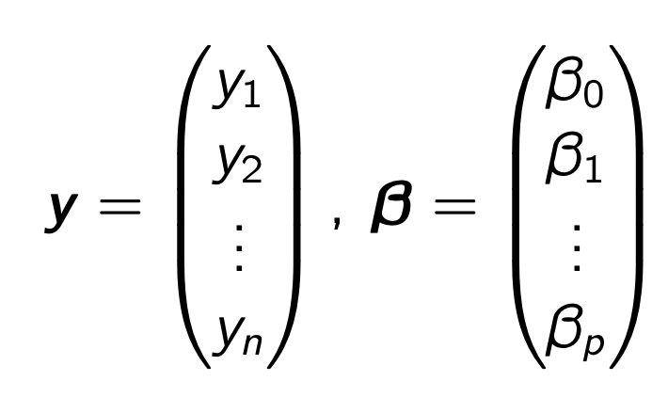
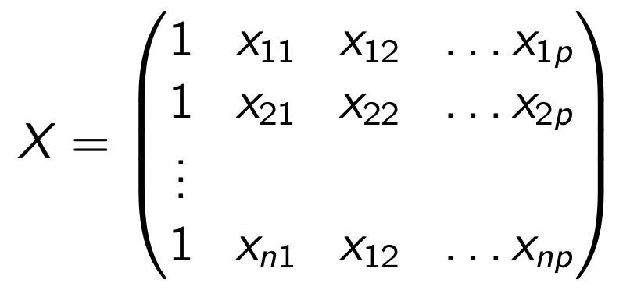
The negative log-likelihood
Example: Suppose we want to estimate p parameters of a linear model and we have n observables,
Suppose each of the yi are random variables with a normal distribution
Then the random vector y can be modelled using a multivariate Gaussian distribution

Slide 18
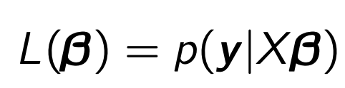
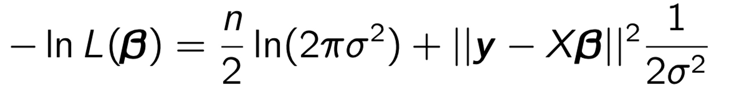
The negative log-likelihood
Remember that the likelihood function
And so

Slide 19
The negative log-likelihood
Remember that the likelihood function
And so
since this term is a constant (since σ is a constant), then minimising the loss is the same thing as minimising this
This is ordinary least squares!

Slide 20
Parameter Uncertainties
As we have discussed before, one way to think about parameter uncertainties is as a standard deviation. Frequentists don’t consider variance for a parameter, but we can think about variance of the estimator for a parameter!
Suppose the estimator is Gaussian distributed
We can directly obtain the value of σ from the second derivative of the log-likelihood function

Slide 21
Parameter Uncertainties
Suppose we can’t assume is Gaussian distributed? We can still estimate an uncertainty by looking locally around the log-likelihood maximum …
0

Slide 22
Parameter Uncertainties
Suppose we can’t assume is Gaussian distributed? We can still estimate an uncertainty by looking locally around the log-likelihood maximum …
0
If we identify

Slide 23
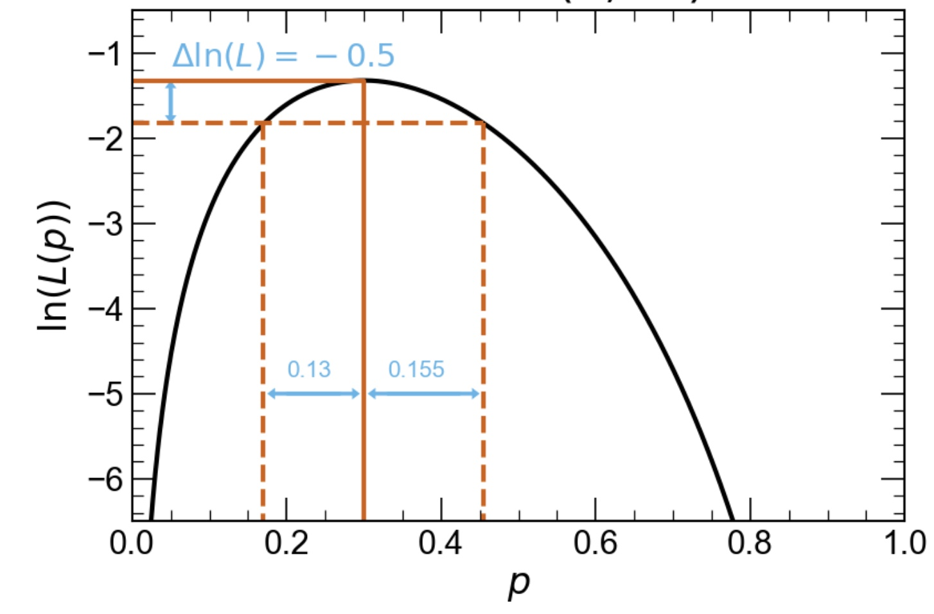
Parameter Uncertainties
Suppose we can’t assume is Gaussian distributed? We can still estimate an uncertainty by looking locally around the log-likelihood maximum …
0
If we identify
→ Obtain the value of from the region over which the log-likelihood reduces by ½
θ
θ

Slide 24
Parameter Uncertainties
Suppose we can’t assume is Gaussian distributed? We can still estimate an uncertainty by looking locally around the log-likelihood maximum …
0
If we identify
→ Obtain the value of from the region over which the log-likelihood reduces by ½
θ
In this week’s notebook, you can find a similar derivation directly from the χ² loss function
We will discuss how this result can be obtained with more rigour and how it relates to hypothesis testing in the discussion session
θ

Slide 25
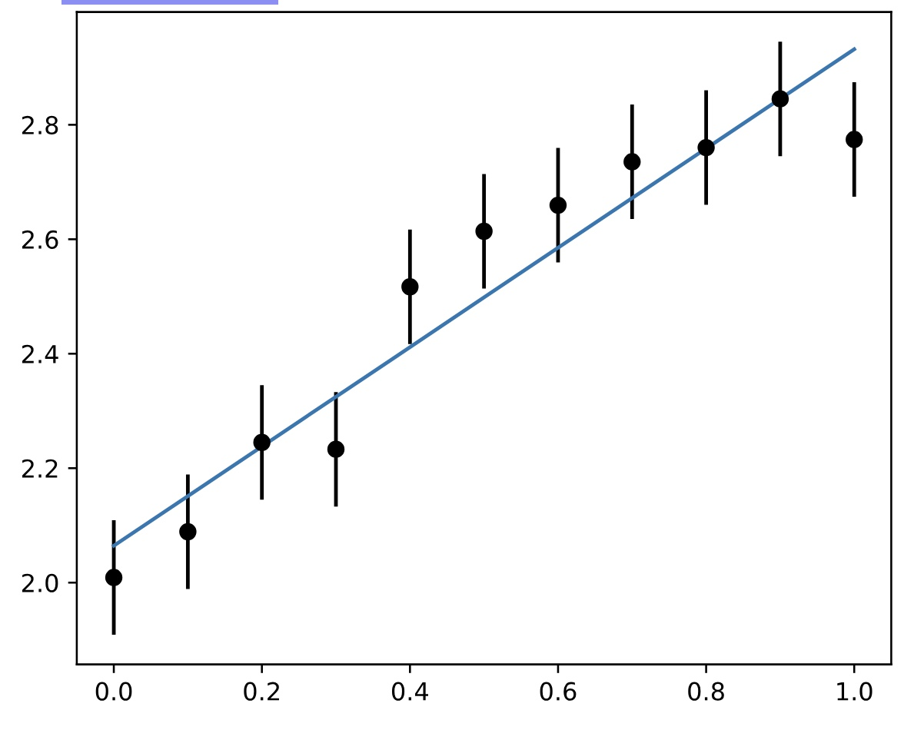
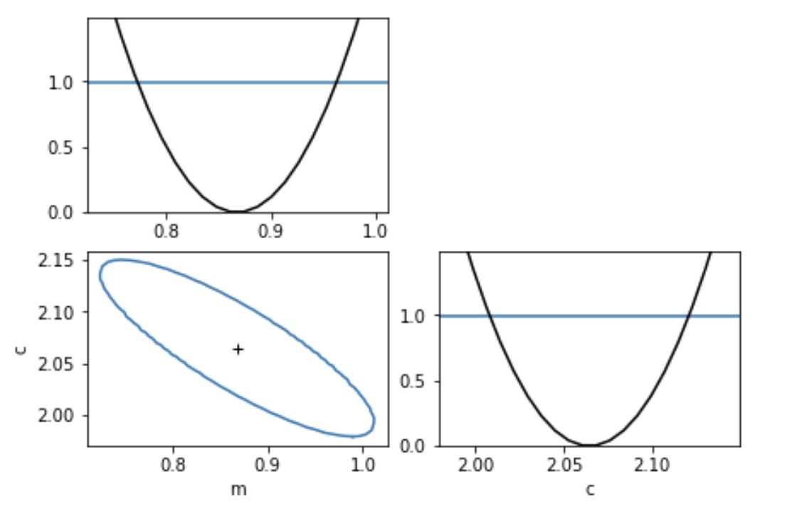
This week’s exercises
This week’s notebook is rather long and there are quite a lot of exercises. The exercises are to get you used to the idea of
Visualizing the data and the model in your parameter estimation problem
Choosing an appropriate loss function
Learning to use iminuit to estimate the parameters and their uncertainties
Using the output from iminuit to determine if the parameter estimates are good or not
Read the material around the exercises

